Slide 1

G2M insight for Cab Investment firm
Data Glacier Virtual Internship - LISUM19
By- B.Harika
Date On: 18/03/2023

Slide 2
Executive Summary
An US based Private Firm Known as XYZ, they are planning to invest in the cab industry and they have provided the Four datasets i.e Cab data, City data, Customer id details, Transaction details.
The analysis are based on the data from two cab companies called Pink Cab Company and Yellow Cab Company

Slide 3
Problem
Statement And analysis
The Problem statement is to identify which cab company is performing better and where XYZ Firm should invest to get better results.
To provide more valuable insights and recommendations to XYZ company, the data was analyzed with following steps:
Checking for missing values, null values, duplicates and Correcting the date formats.
Comparing the total revenue, profits between the two cab companies
Based on the age and gender demographics and identifying the which city has more cab users.
This analysis helps in research on overall cab companies i.e. Pink cab and Yellow cab Companies, in the US to gain more deeper understanding on market trends and growth of opportunities.

Slide 4
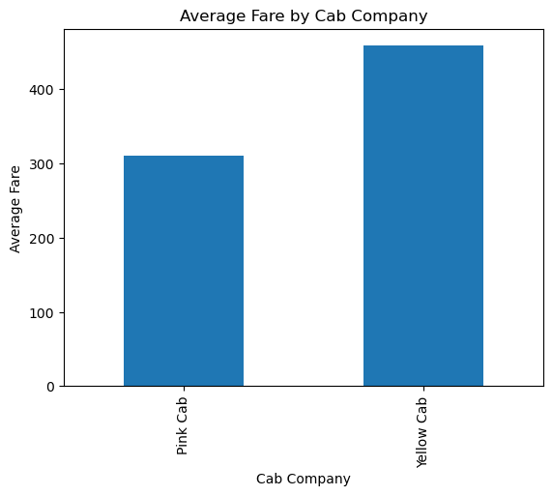
Average Fare By Each Cab Company
The above bar chart shows the average of each Cab Company, and comparatively Yellow cab has more average fare than the Pink Cab Company.

Slide 5
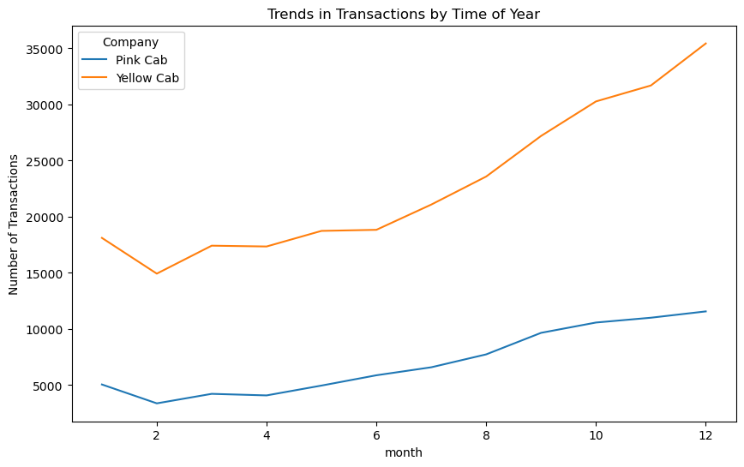
Trends in Transactions by Time of Year
After conducting a thorough analysis of the trends, it has been found that the Yellow Cab Company has a higher number of monthly transactions when compared to the Pink Cab Company.
This clearly indicates that the Yellow cab company is performing better in terms of its business operations and also generating more revenue than the pink cab company.

Slide 6
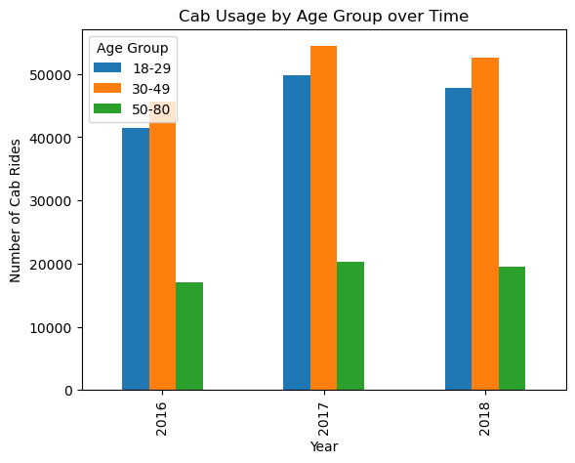
Cab Usage by Age Group over Time
Based on the data gathered from 2016 to 2018, and above charts it can be concluded that the age group ranging from 30 to 49 years old has exhibited the highest usage of cabs than the other age group.
Thus, this certain age group should be targeted to improve the performance and increase business opportunities for cab company.

Slide 7
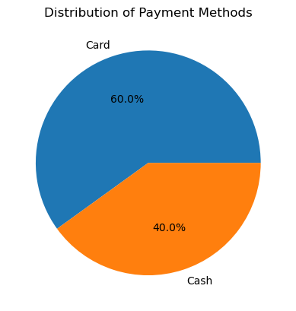
Distribution of Payment Methods
From the above chart, it shows that majority of cab users are preferring to the fare through cards i.e. 60% than cash.

Slide 8
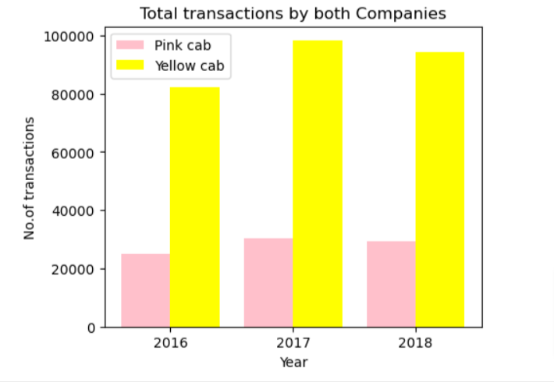
Total Transactions by both Companies
From the above graph, the Yellow cab has Highest number of transactions in 2017 & 2018.

Slide 9
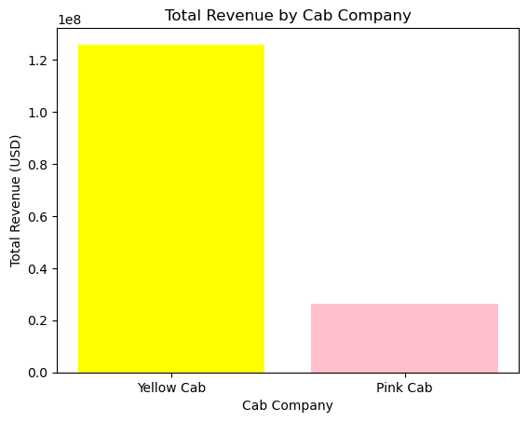
Total Revenue by Cab Company
From the above bar chart, it is clear that Yellow cab company has generated maximum Revenue when compared to Pink cab company.
This indicates that Yellow cab company is more successful in generating revenue by using their business strategy than the Pink cab company.

Slide 10
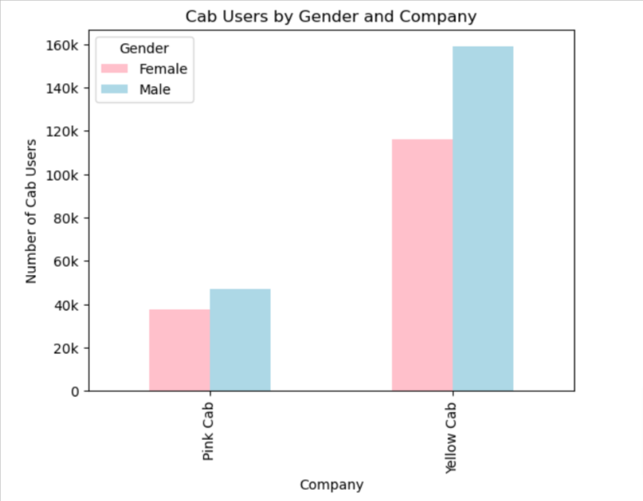
Cab Users by Gender and Company
From the above chart, after analyzing it is concluded that there is a higher frequency of cab usage among males than females.
This trend is observed across the genders and company, it concludes that males are the primary consumers.

Slide 11
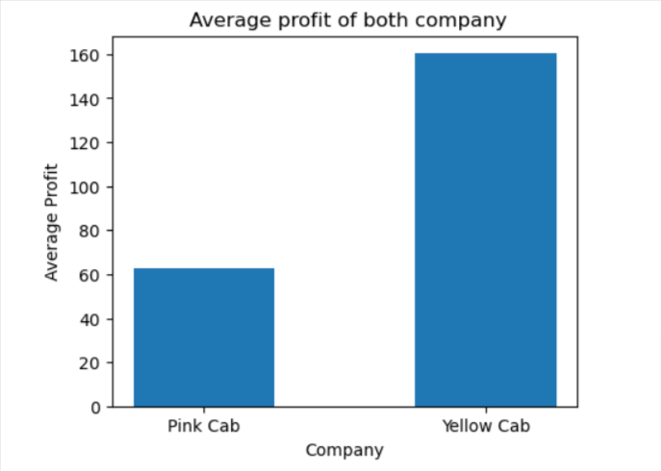
Average Profit of Company
From the above chart, the average profit of yellow cab company is nearly 2.5x higher than Pink cab.

Slide 12
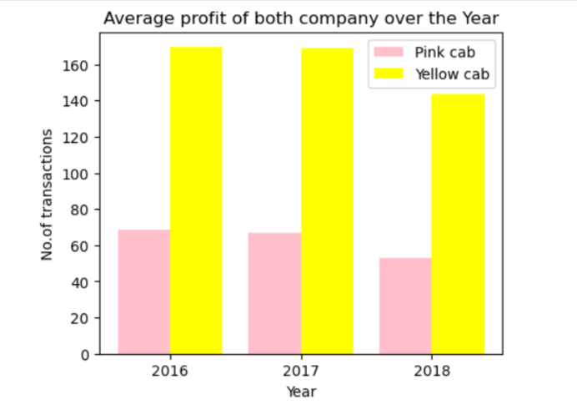
Average Profit of Company over the year
From the Chart, its evident that the average profit of the both companies has seen declining. But throughout all years, Average profit of Yellow cab is 2.5x times more than pink cab.

Slide 13
Recommendations
Target the age group of 30-49: As this age group has been observed to utilize cabs more frequently than other age groups, cab service providers can target their customers based on this age group to maximize revenue and growth.
Gender-based strategies: As males have been observed to use cab services more frequently than females, cab service providers can consider on implementing gender-based marketing strategies.
Payment mode: Maximum customers, has opted to pay the fare by Cards (i.e. 60% of cab users) than the cash.
Total revenue and Profit : Yellow cab companies earn more revenue than the pink cab companies, even in Profit margins, other expenses, and ROI Yellow cab companies are earning more than Pink cab companies.
Transaction Trends: After analyzing the monthly trends, it shows that Yellow cabs has highest transactions than the pink cabs.
Average Fare price and Waiting time: Yellow cab has maximum price when compared to pink cab company (i.e. 1X). Waiting time data can be used to optimize their operations and increase customer experience, therefore it will add advantage to the company.
Conclusion:
After analyzing the data of two cab companies, It is recommend to the US based XYZ firm to invest in Yellow cab company.

Slide 14
THANK YOU
By B.Harika

